Slide 1
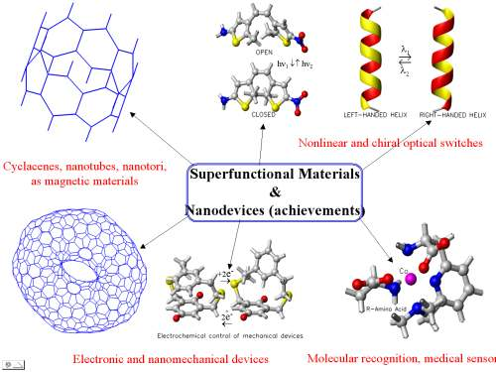
Research Area
Project #1 Superfunctional Materials and Nanodevices

Slide 2
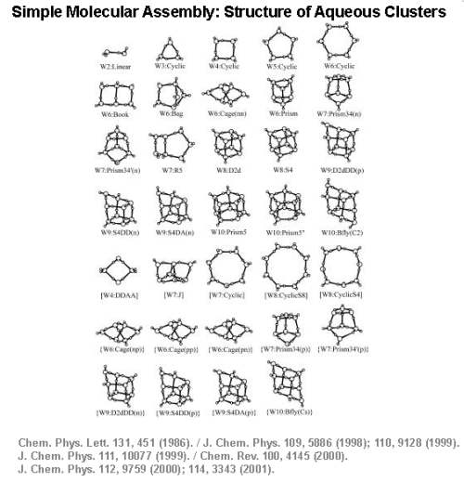
Research Area
Project #2 Structure of Water Clusters

Slide 3
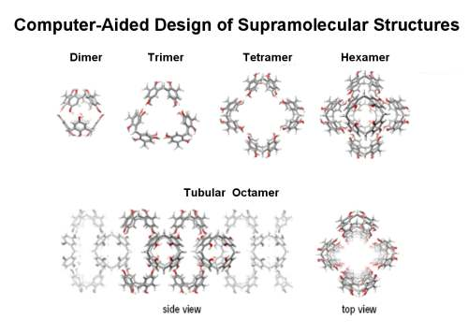
Research Area
Project #3 Computer-Aided Design of Supramolecular Sturctures

Slide 4
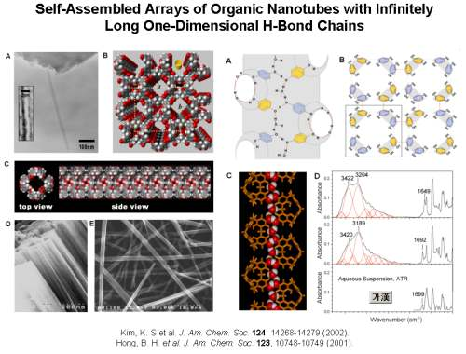
Research Area
Project #4 Synthesis of Organic Nanotubes & 1-Dimensional Hydrogen Bond Chains

Slide 5
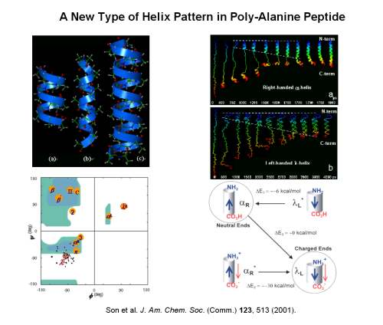
Research Area
Project #5 Coil and De-coil of Poly-Alanine Peptide

Slide 6
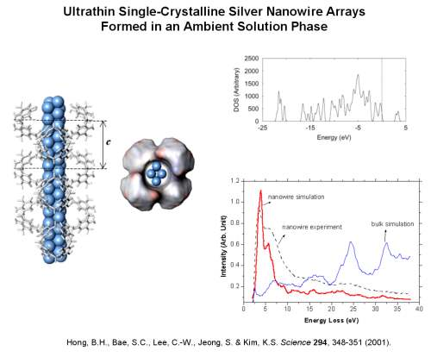
Research Area
Project #6 Synthesis of Ultrathin Metalic Nanowire with Organic Nanotubes

Slide 7
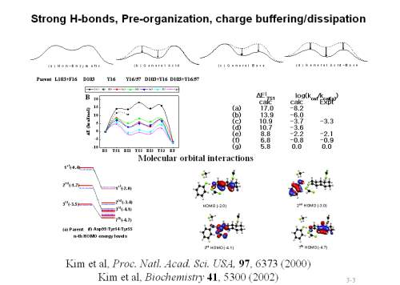
Research Area
Project #7 Study of Strong H-bonds, Pre-organization, Charge Buffering/Dissipation

Slide 8
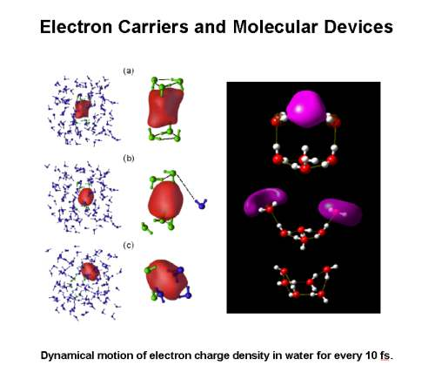
Research Area
Project #8 Molecular Dynamics of Excess Electrons in Aqueous Solution

Slide 9
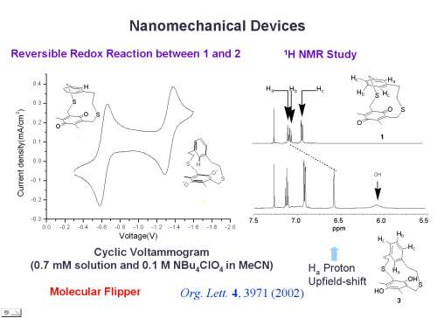
Research Area
Project #9 Nanomechanical Devices: Molecular Flipper

Slide 10
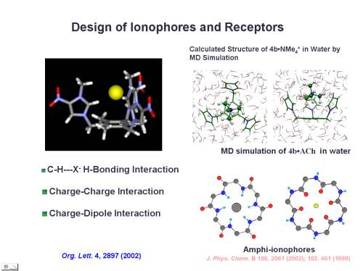
Research Area
Project #10 Denovo Design of Ionophores and Molecular Receptors

Slide 11
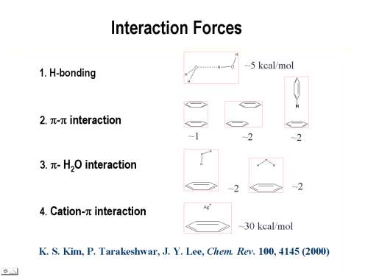
Research Area
Project #11 Comprehensive Study of Interaction Forces

Slide 12
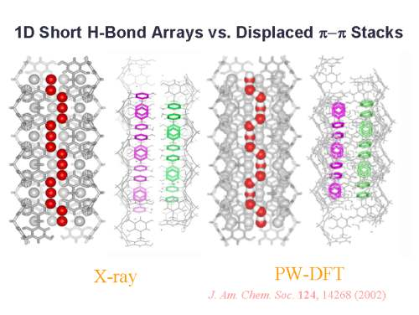
Research Area
Project #12 Theoretical and Experimental Study of 1-Dimensional Arrays in Organic Nanotubes

Slide 13
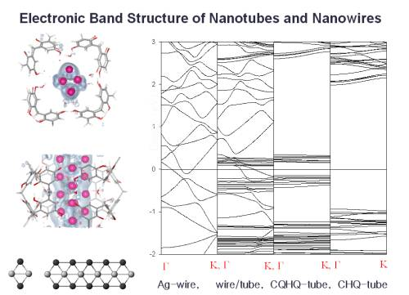
Research Area
Project #13 Electronic Band Structure of Nanotubes and Nanowires

Slide 14
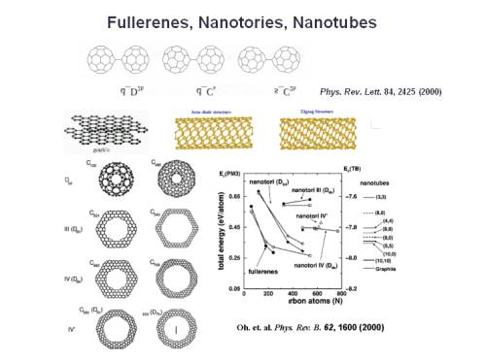
Research Area
Project #14 Synthesis of Cabon-based Nanoelectronic Materials

Slide 15
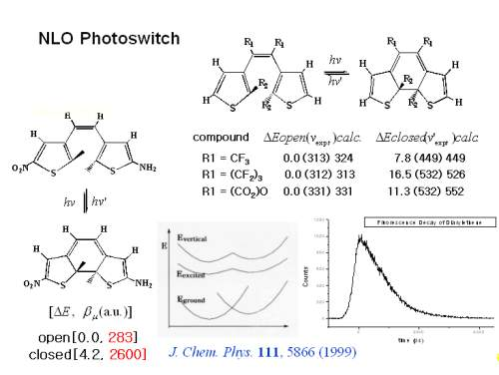
Research Area
Project #15 Nonlinear Optical Photoswitches

Slide 16
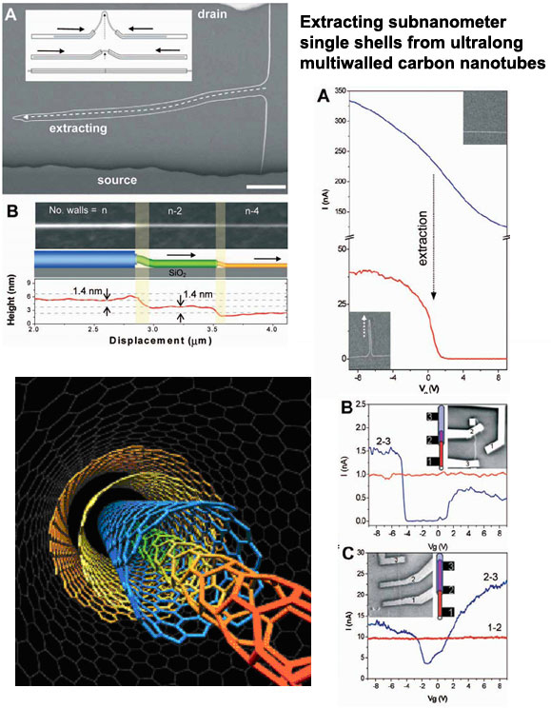
Research Area
Project #16 Carbon-based Nanoelectronic Devices : Extracting Single-wall Carbon Nanotubes

Slide 17
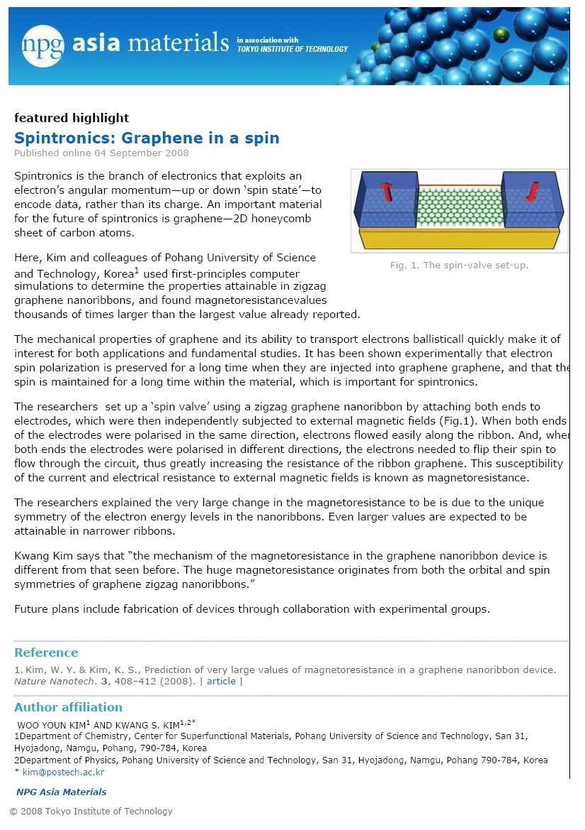
Research Area
Project #17 Carbon-based Nanoelectronic Devices : Graphene in a spin

Slide 18
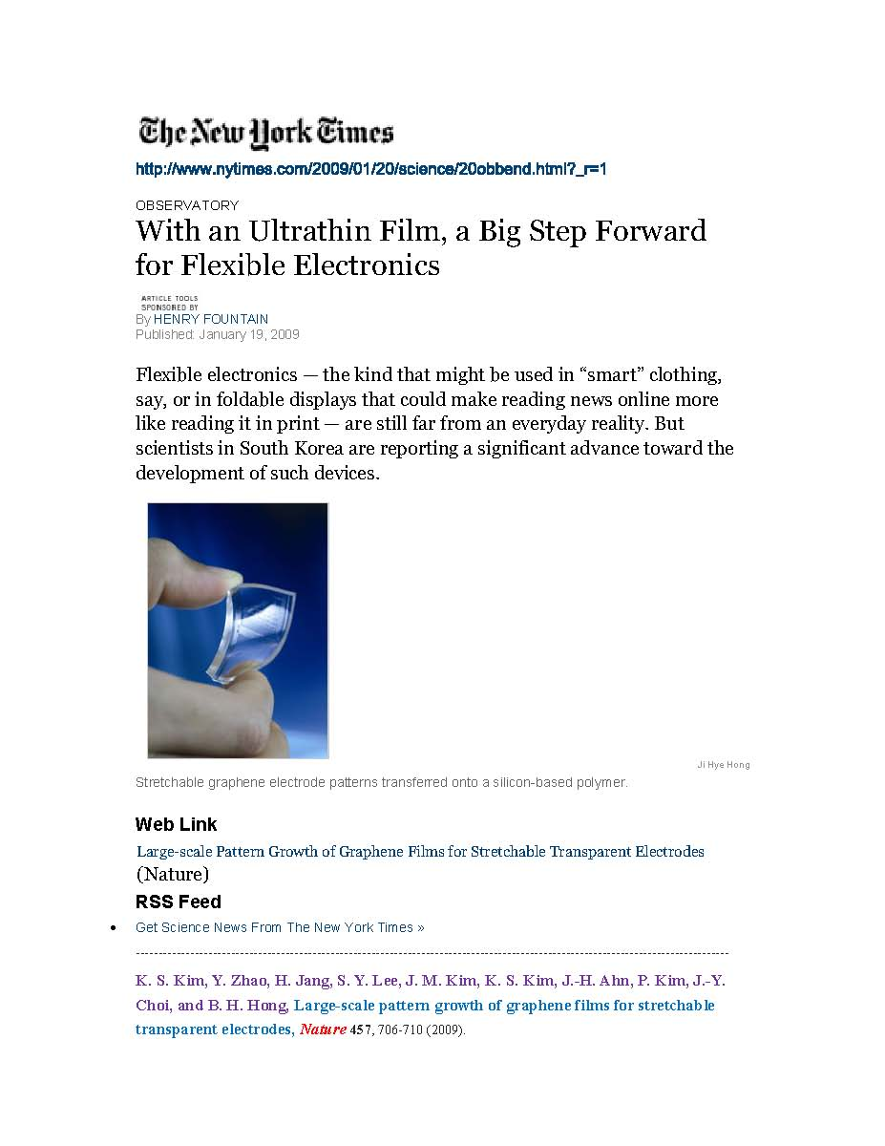
Research Area
Project #18 Carbon-based Nanoelectronic Devices : Pattern Growth of Graphene Films

Slide 19
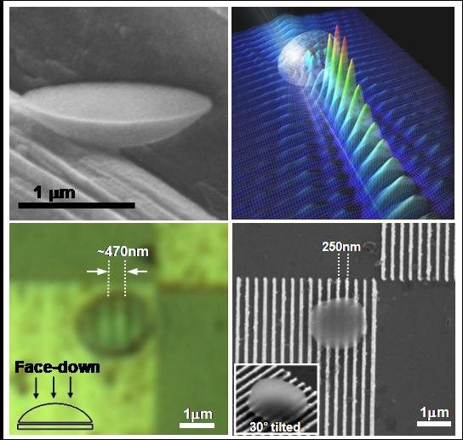
Research Area
Project #19 Nano-optics : Synthesis of Organic Nanolenses and Theoretical Study of the Optical Properties

Slide 20
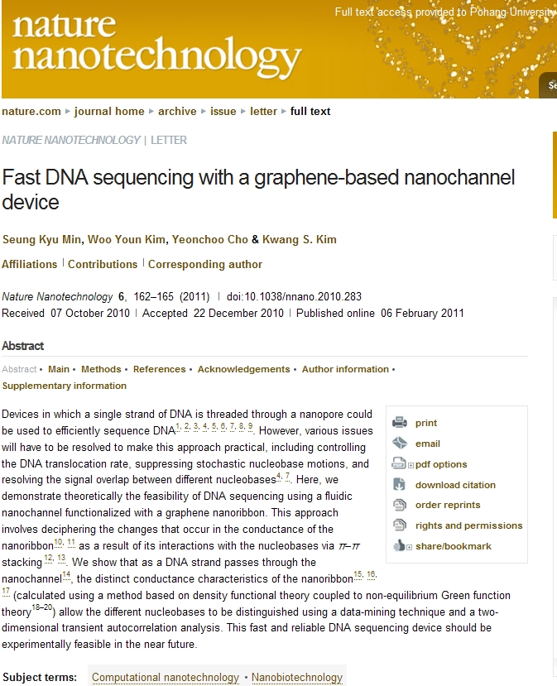
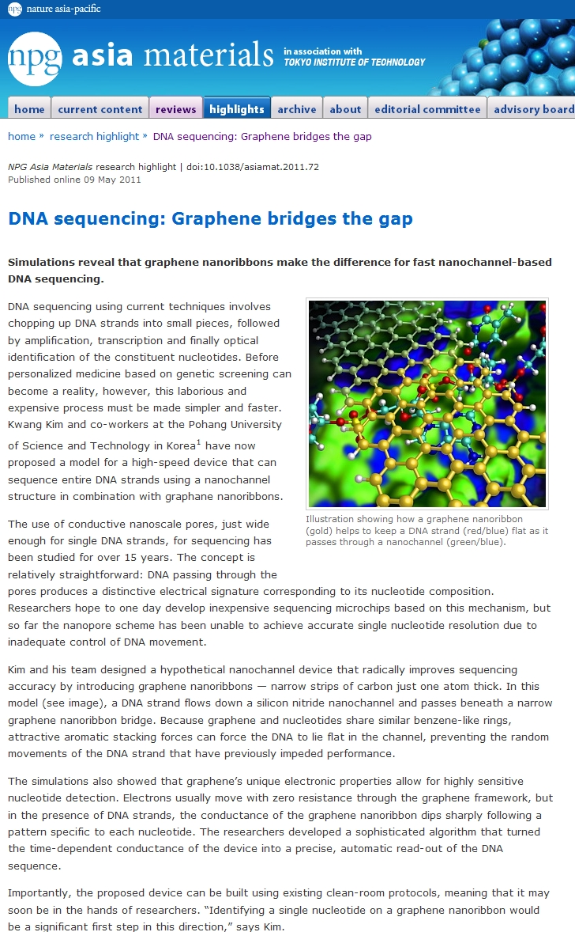
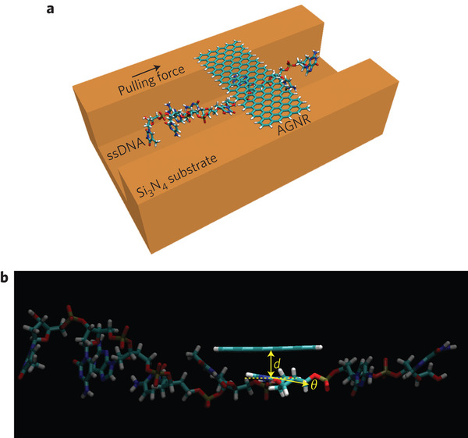
Research Area
Project #20 Fast DNA sequencing with a graphene-based nanochannel device

Slide 21
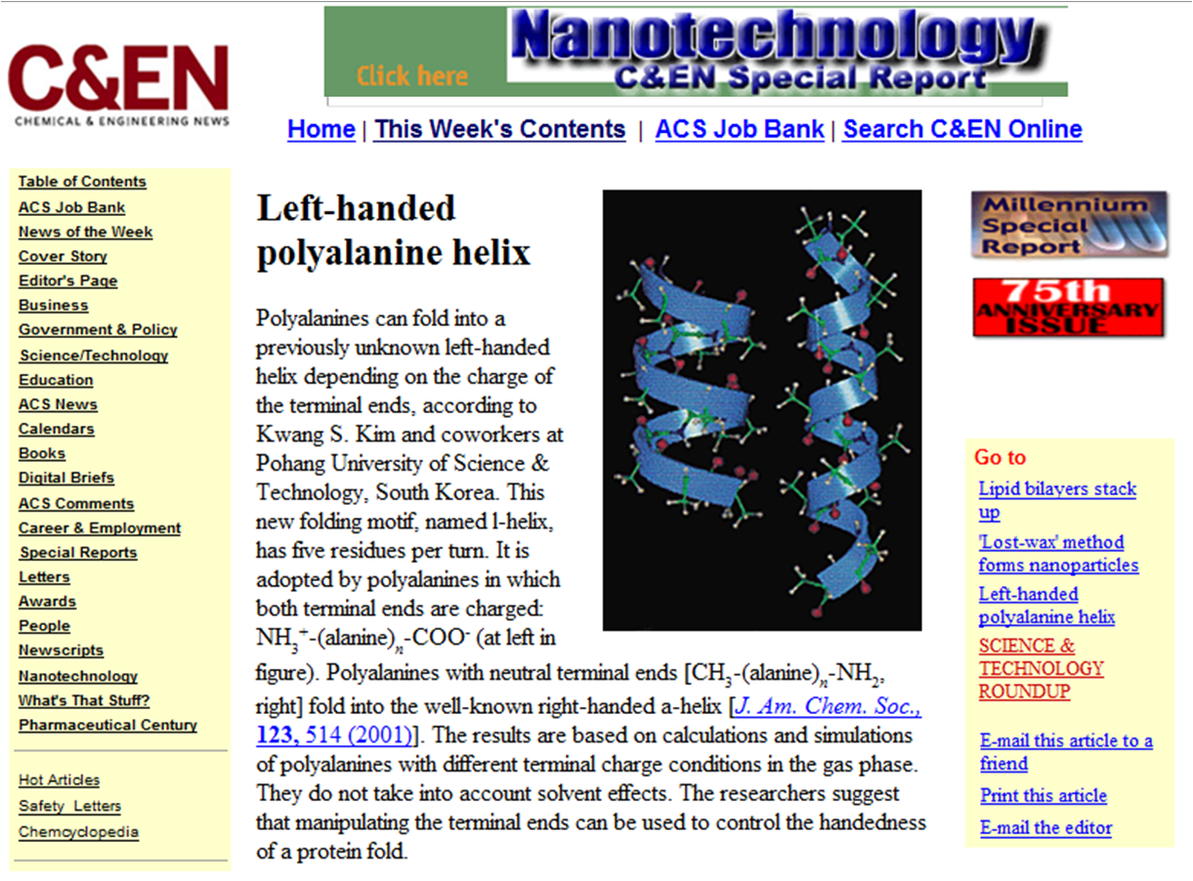
Highlights
1 Left-handed polyalanine helix (JACS, 2001, 123, 514)

Slide 22
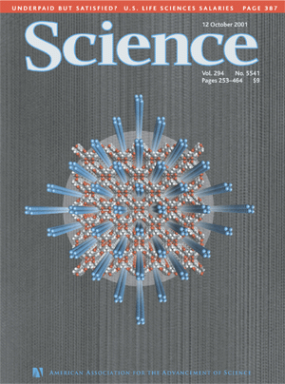
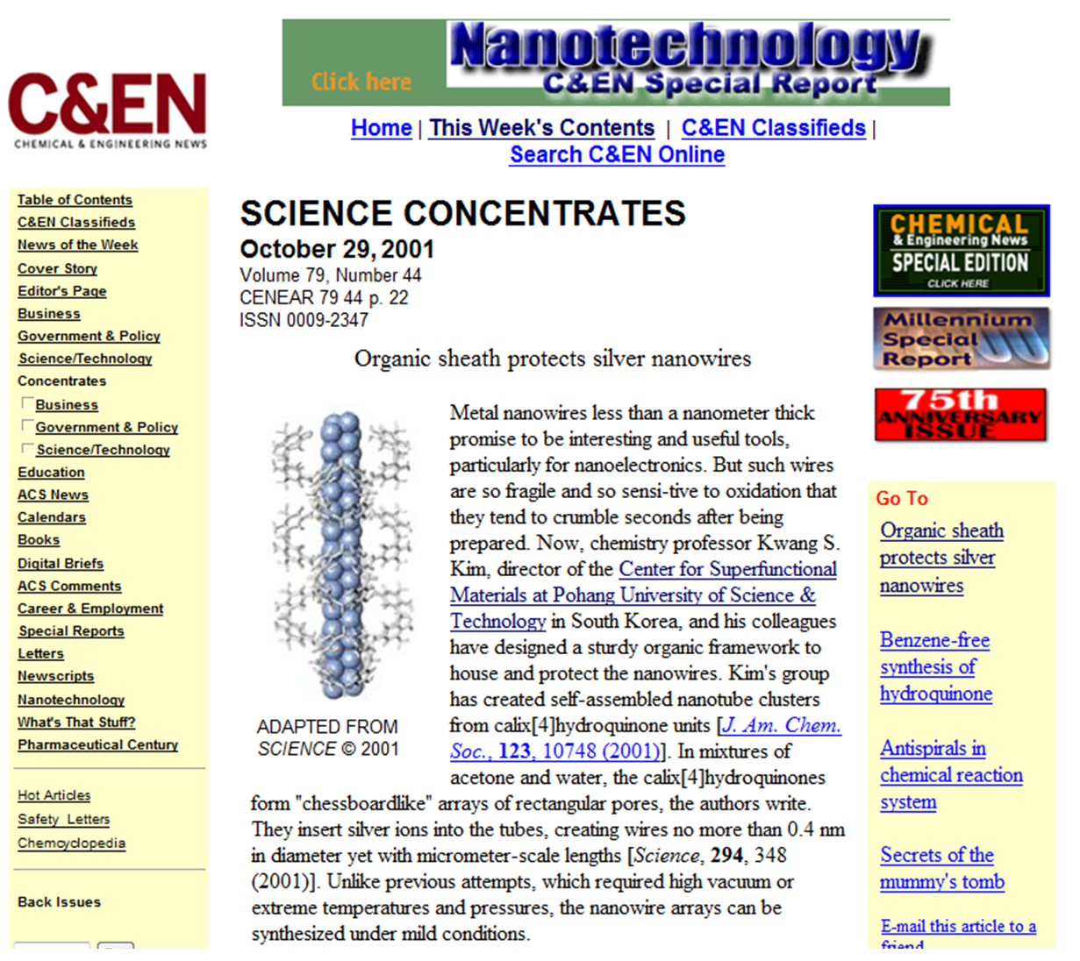
Highlights
2 Ultra Single-Crystalline Silver Nanowire Arrays (Science, 2001, 294, 348, Cover)

Slide 23
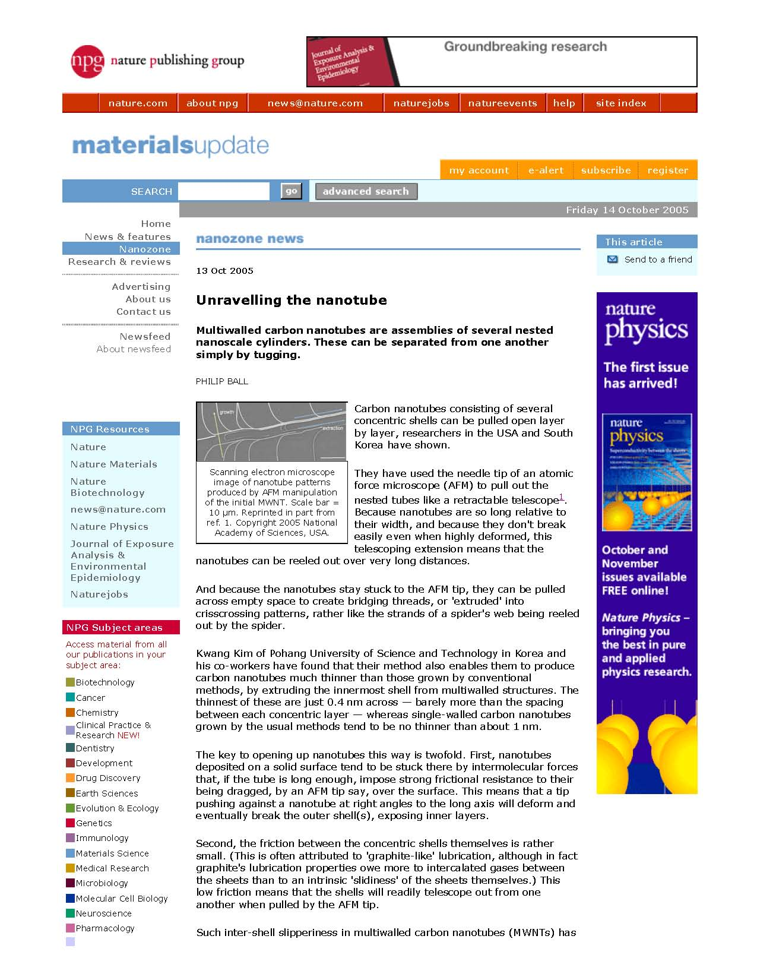
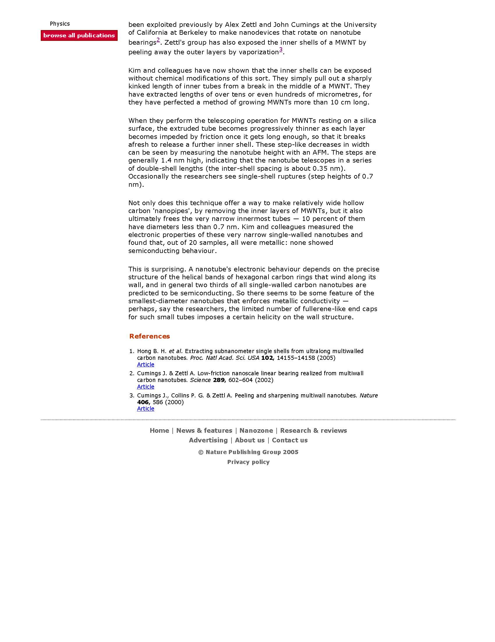
Highlights
3 Extracting single wall nanotube (PNAS, 2005, 102, 14155)

Slide 24
Highlights
4 Spintronics: Graphene in a spin (Nature Nanotech., 2008, 3, 408)

Slide 25
Highlights
5 Large-scale pattern growth of graphene films (Nature, 2009, 456, 706)

Slide 26
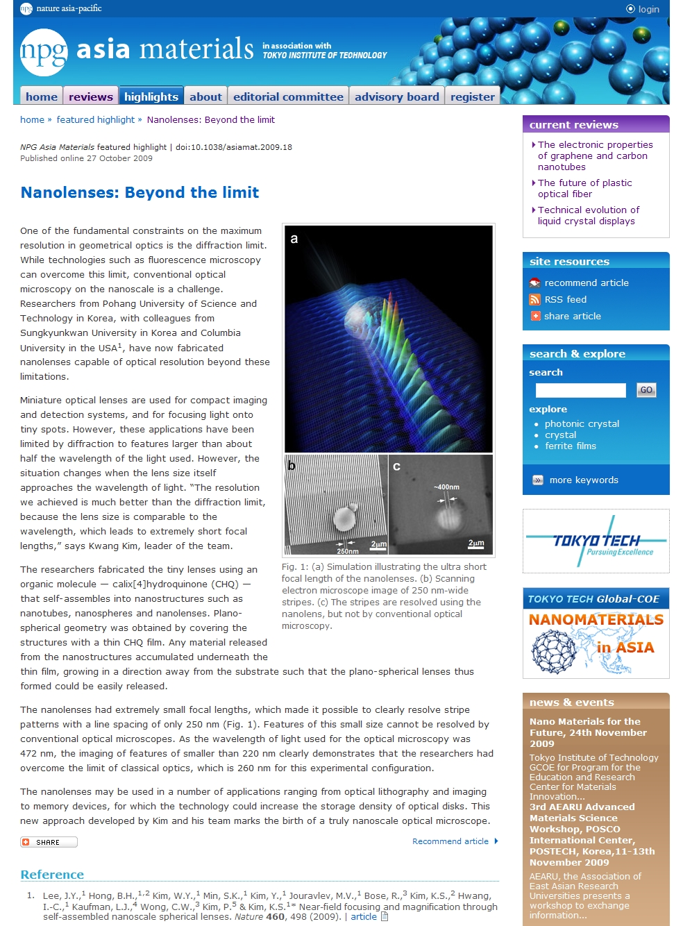
Highlights
6 Nanolenses: Beyond the limit (Nature, 2009, 460, 498)

Slide 27
Highlights
7 Fast DNA sequencing with a graphene-based nanochannel device, Nature Nanotechnology (Nature, 2009, 460, 498) and NPG Asia Materials

